Slide 1
Continuing Your Education and Further Reading

Slide 2
Where Do You Go from Here?
“To stay competitive in the tech industry, never stop learning. Always be on the lookout for better ways of doing things and new technologies. Our industry does not reward people who let themselves stagnate.”
–John Hall, Senior Vice President, Oracle University
This appendix provides a few resources to help you with continuing your education.
Notes:
Oracle Database 11g: Administration Workshop I G - <number>

Slide 3
Continuing Education Resources
Resources to learn more about working with Oracle Database 11g include:
  Oracle University Web site
  Oracle University Knowledge Center
  Oracle Technology Network:
    Oracle by Example
    Oracle Magazine
    Oracle Database product page
  Technical support: My Oracle Support
  Oracle Database product page
Notes:
Oracle Database 11g: Administration Workshop I G - <number>

Slide 4
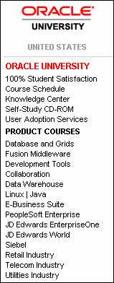

Oracle University
Learn Oracle from Oracle! No one knows Oracle technology better than Oracle University.
  Worldwide education services
  100% student satisfaction
  Learn with the format that best suits your needs:
    Instructor-Led Inclass Training
    Live Web Class
    Self-Study CD-ROMs
  Certification
http:// www.oracle.com/education
Notes:
Oracle Database 11g: Administration Workshop I G - <number>
Oracle University
Oracle University is the world’s largest corporate educator with education centers around the globe. The goal is 100% student satisfaction.
Oracle certifications are tangible, industry-recognized credentials that provide measurable benefits to IT Professionals and their employers. Numerous certification paths exist, for example, for DBAs:
Oracle Certified Associate (OCA)
Oracle Certified Professional (OCP)
Oracle Certified Master (OCM), and
Specialty certifications, for example, Oracle 10g: Managing Oracle on Linux Certified Expert

Slide 5
Continuing Your Education
  Database specialty classes:
    Oracle Database 10g: Administration Workshop II
    Oracle Database 11g: Performance Tuning
    Oracle Database 11g: Security
  Other specialty classes:
    Oracle 11g: RAC and Grid Foundation Administration
    Oracle Database 11g: RAC Administration
Notes:
Oracle Database 11g: Administration Workshop I G - <number>
Continuing Your Education
The Oracle Database 10g: Administration Workshop II course provides additional training as a database administrator. You cover advanced database recovery strategies, performance monitoring and tuning, and distributed data concepts. Oracle recommends that you complete this course before beginning specialty courses. Additional courses are available on topics that can enhance your abilities as an Oracle database administrator, such as:
Oracle Database 11g: Performance Tuning
Oracle Database 11g: Security
Other specialty courses include Oracle 11g: RAC and Grid Foundation Administration and Oracle Database 11g: RAC Administration.
Consult the Oracle University Web site for an up-to-date list of all courses. Consult the Oracle University Learning Paths for more suggested courses for your job description.

Slide 6
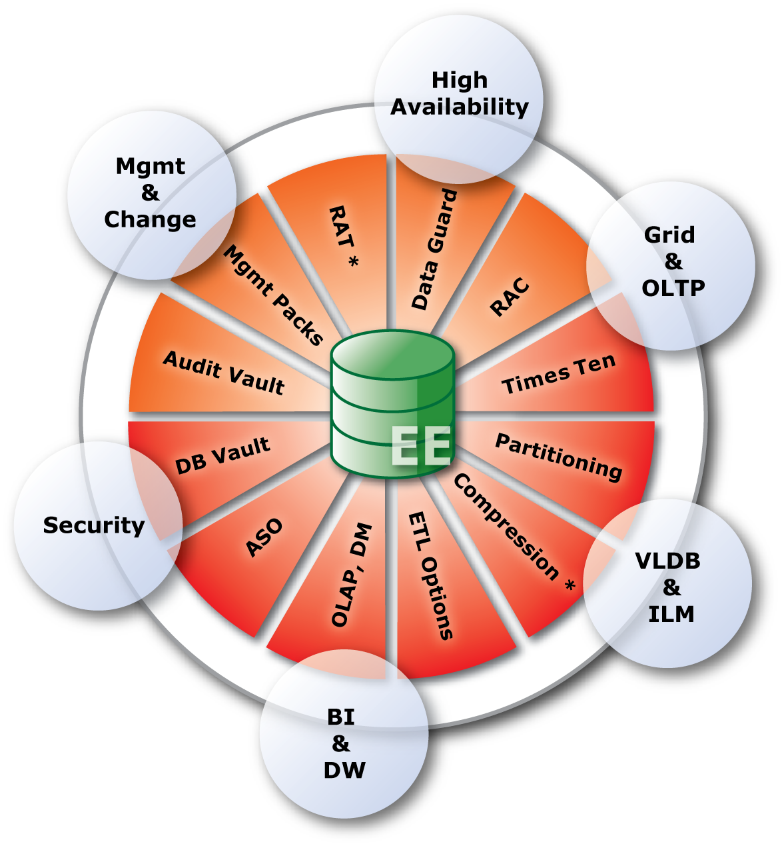
Database Specialty Areas
Modern Enterprise Grids
  Real Application Clusters
  Management packs
  TimesTen In-Memory Database
Information Lifecycle Management
  Partitioning
  Advanced Compression
Data Warehousing
  Oracle Information Appliances
  OLAP, Mining, Warehouse Builder
Governance, Risk & Compliance
  Security Options
  Total Recall
Change management
  Real Application Testing
Notes:
Oracle Database 11g: Administration Workshop I G - <number>

Slide 7
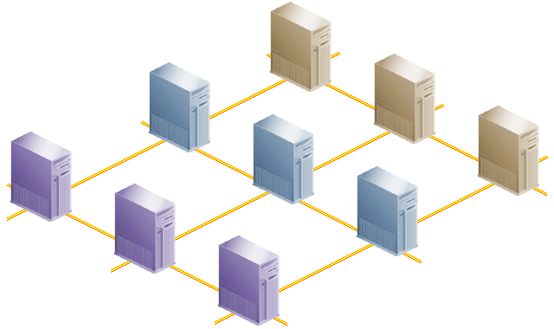

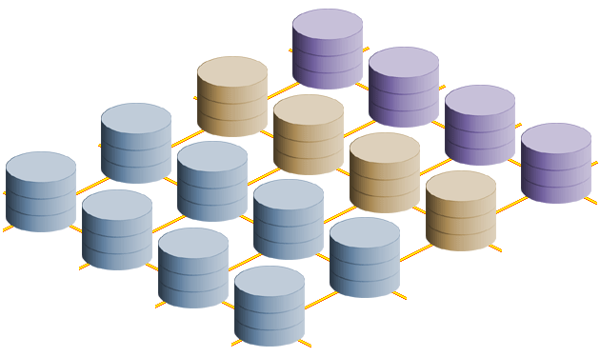
Oracle Real Application Clusters
  Consolidating different workloads to a single grid
  Virtualizing the information platform
  Flexible physical infrastructure (including dedicated servers)
Databases
Storage
Notes:
Why use RAC?
Oracle Real Application Clusters (RAC) enables high utilization of a cluster of standard, low-cost modular servers such as blades. RAC offers automatic workload management for services. Services are groups or classifications of applications that comprise business components corresponding to application workloads. Services in RAC enable continuous, uninterrupted database operations and provide support for multiple services on multiple instances. You assign services to run on one or more instances, and alternate instances can serve as backup instances. If a primary instance fails, Oracle moves the services from the failed instance to a surviving alternate instance. Oracle also automatically load-balances connections across instances hosting a service.
RAC harnesses the power of multiple low-cost computers to serve as a single large computer for database processing, and provides the only viable alternative to large-scale SMP boxes for all types of applications. RAC, which is based on a shared-disk architecture, can grow and shrink on demand without the need to artificially partition data among the servers of your cluster. RAC also offers a single-button addition and removal of servers to a cluster. Thus, you can easily provide or remove a server to or from the database.

Slide 8

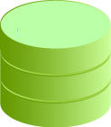



Oracle Data Guard
Synchronous or asynchronous redo transport
Standby databases, for example:
For reporting: Logical standby database with additional materialized views
For QA and testing: Physical/ Snapshot standby with the changes queued
For off-site queries: Physical standby
Primary
database
Oracle Net
Observer: Initiating fast-start failover
Production Database
Database copies
Notes:
Oracle Data Guard
Oracle Data Guard is a management, monitoring, and automation software infrastructure that works with a production database and one or more standby databases to protect your data against failures, errors, and corruptions that might otherwise destroy your database. It protects critical data by providing facilities to automate the creation, management, and monitoring of the databases and other components in a Data Guard configuration. It automates the process of maintaining a copy of an Oracle production database (called a standby database) that can be used if the production database is taken offline for routine maintenance or becomes damaged.
In a Data Guard configuration, a production database is referred to as a primary database. A standby database is a synchronized copy of the primary database. Using a backup copy of the primary database, you can create from one to nine standby databases. The standby databases, together with the primary database, make up a Data Guard configuration. Each standby database is associated with only one primary database.
Note: You can use the Cascaded Redo Log Destinations feature to incorporate more than nine standby databases in your configuration.
Configuring standby redo log files is highly recommended on all standby databases in a Data Guard configuration, including the primary database to aid in role reversal.

Slide 9


Streams Overview
Source database
Target database
Propagate
Capture
Apply1
Redo logs
Apply2
Transparent Gateway
Non-Oracle
database
Notes:
Oracle Database 11g: Administration Workshop I G - <number>
Streams Overview
A stream is a flow of information either within a database or from one database to another. Oracle Streams is a set of processes and database structures that enable you to share data and messages in a data stream. The unit of information that is put into a stream is called an event:
DDL or DML changes, formatted as an LCR
User-created events
Events are staged in and propagated between queues.
Most people think of Streams as replication where all databases can be updatable, and without platform or release considerations. Characteristics include:
All sites: Active and updateable
Automatic conflict detection and optional resolution
Supporting data transformations
Flexible configurations: n-way, hub & spoke, and so on
Different database platforms, releases and schemas
Providing high availability for applications (where update conflicts can be avoided or managed)

Slide 10
Notes:
Oracle Database 11g: Administration Workshop I G - <number>
Oracle Streams: Basic Elements
By using Oracle Streams, you can share data and events in a data stream, either within a database or from one database to another.
Oracle Streams uses queues to stage events for propagation or consumption. You can use Oracle Streams to propagate events from one queue to another, and these queues can be in the same database or in different databases. You may stage two types of events in a queue used by Streams: captured events (logical change records, or LCRs) and user-enqueued events (which can be messages or LCRs):
Changes to the database can be captured from the redo logs. You can then format these changes into LCRs. The LCRs can represent data manipulation language (DML) or data definition language (DDL) changes. The database where changes are generated in the redo log is called the source database.
You can also enqueue user events explicitly with a user application. These explicitly enqueued events can be LCRs or user-created messages. A message is the smallest unit of information that is inserted into and retrieved from a queue. A message consists of data as well as information to govern the interpretation and use of the message data.
You can divide Oracle Streams into a small set of tasks. By configuring these tasks, you can control what information is put into a stream, how the stream flows from node to node, what happens to events in the stream as they flow into each node, and how the stream terminates.
You can customize each task to address specific requirements and business needs. The result is a new feature that provides greater functionality and flexibility than traditional solutions for capturing and managing events, and for sharing the events with other databases and applications. Oracle Streams provides the capabilities that are needed to build and operate distributed enterprises and applications, data warehouses, and high-availability solutions.
The three basic tasks of Oracle Streams are:
Capture: To capture DML or DDL events automatically from the redo log. User-created events are not captured automatically but are placed into a queue via an explicit enqueue operation.
Staging: To store and propagate events between databases. Propagation can be performed explicitly if needed.
Apply: To apply DML or DDL events to a destination database or to pass the events to an application.
You can perform these tasks in a single database or combine them with tasks in other databases to form a distributed environment.
Multi-Database Streams
Events propagate between the staging areas in each database. The capture and consumption elements can be active in any database. For example, you can configure bidirectional data replication with a capture process, propagation job, and apply process at each site. Or, you can have a single-source system with capture and propagation at one site and apply at several other databases. You can also have an arbitrary number of databases. Some of the more complex environments may need hundreds of databases sharing information with Oracle Streams.

Slide 11

Oracle Technology Network
Oracle Technology Network is a free resource with information about the core Oracle software products, including database, Application Server, Collaboration Suite, and development tools. You can have access to:
  Technology centers
  Discussion forums
  Software downloads
  Online documentation
  Oracle by Example
  Code samples
    ... and much more!
http://www.oracle.com/technology
Notes:
Oracle Database 11g: Administration Workshop I G - <number>
Oracle Technology Network
Oracle Technology Network (OTN) hosts the latest news about Oracle technology and products. Additionally, OTN provides peer-to-peer forums, white papers, security bulletins, and other vital information for the Oracle professional.
In addition to tips, tricks, and techniques for getting the most out of your Oracle software, you can download that software from OTN. Remember that all software downloads are free; each comes with a development license that allows you to use full versions of the products only when developing and making prototypes of your applications.

Slide 12
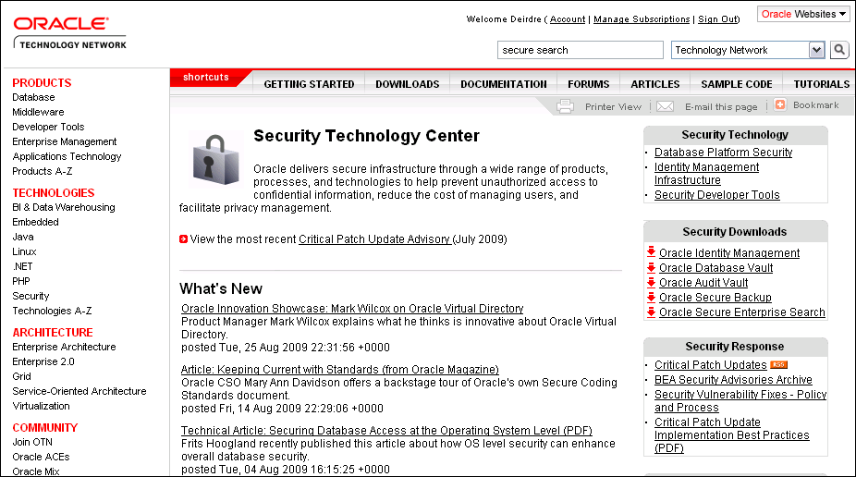
Security
http://www.oracle.com/technology/deploy/security/index.html
Notes:
Security
For more information about all security-related aspects of the database, visit the “Security Technology Center,” which is updated regularly.

Slide 13
Oracle by Example
  What is an OBE?
    A set of hands-on, step-by-step instructions
  Where can I find them?
    http://www.oracle.com//technology/obe
  What is available?
      Hundreds of OBE tutorials on many of the Oracle product areas
Notes:
Oracle by Example
The Oracle by Example (OBE) series provides hands-on, step-by-step instructions on how to use various new features of Oracle products. OBEs help to reduce the time spent on learning a new product capability and enhance the users’ understanding of how the feature can be implemented in their environment. Currently, OBEs are available for the Oracle database, Fusion Middleware, Oracle Application Server, Oracle Enterprise Manager Grid Control, Oracle Collaboration Suite, JDeveloper, and Business Intelligence. OBEs can be accessed at http://www.oracle.com/technology/obe.

Slide 14

Oracle Magazine
  Free subscription
  Oracle Magazine Archives
  http://www.oracle.com/technology/oramag/index.html
Notes:
Oracle Magazine
Among the many different types of resources to which you have access from OTN is Oracle Magazine. You can receive your free subscription also by mail.

Slide 15

Oracle Applications Community
Oracle Technology Network is a resource for Oracle Applications users and implementers. You can have access to:
  Discussion forums
  User groups
  Online chat
  Documentation
  Training
  Upgrade information
    … and much more!
http://www.oracle.com/technology/community/apps/index.html
Notes:
Oracle Database 11g: Administration Workshop I G - <number>

Slide 16

Technical Support: My Oracle Support
Access to My Oracle Support is included as part of your annual support maintenance fees. In addition to the most up-to-date technical information available, My Oracle Support gives you access to:
  Service requests (SRs)
  Certification matrices
  Technical forums monitored by Oracle experts
  Software patches
  Bug reports
http://metalink.oracle.com
Notes:
Oracle Database 11g: Administration Workshop I G - <number>
Oracle MetaLink
My Oracle Support is your gateway to Oracle’s Support resources. Here you find answers to the most common issues facing Oracle administrators and developers, as well as resources to solve many of those issues.
Like Oracle Technology Network, My Oracle Support includes the most recent headlines about issues that affect the Oracle professional.

Slide 17
Oracle Database Product Page
From the Oracle Database product page on OTN, there are links to:
  Database Focus Areas
  White Papers
  Option Data Sheets
  Related technologies
  Discussions
  Other useful resources
Notes:
Oracle Database 11g: Administration Workshop I G - <number>
Oracle Database Product Page
From the Oracle Database product page on OTN, there are links to useful information such as:
Database Focus Areas: Provides links to other database-related focus areas such as Grid/Clustering, High Availability, Performance, and Manageability
White Papers: Provides detailed information to help you learn more about the Oracle Database 11g product family
Option Data Sheets: Provides detailed information about the various Oracle Database 11g options
Related technologies: Provides links to related technologies such as Oracle Application Express and Oracle SQL Developer
Discussions: Provides links to ongoing discussions related to Oracle Database 11g
Other resources: Links to documentation, forums, links for learning more, and other useful resources
The documents here are live documents that are updated whenever the need arises, as well as new documents that may be added at any time. Check back regularly to find the latest information available.

Slide 18
Thank You!
We hope your experience with Oracle University has been enjoyable. We welcome your feedback on how we can improve to better meet your needs:
  End-of-course evaluations
  Oracle University Office of Customer Satisfaction
  Oracle Education Services
We hope to see you in class again soon.
Notes:
Oracle Database 11g: Administration Workshop I G - <number>
Thank You!
Oracle University’s mission is to enhance the adoption of Oracle technology. Our goal is to partner with you, providing information that is pertinent, timely, and relevant to your needs.
Please take a minute to complete the end-of-course evaluation and let us know how we can serve you better. In the U.S., feel free to e-mail our office of customer satisfaction at:
customersat_us@oracle.com
If you have questions about continuing your Oracle education, need help finding a class, or want to arrange for on-site training at your company, contact Oracle Education Services for assistance. In the U.S., dial 800.529.0165. For contact numbers outside the U.S., visit the following Web site:
http://www.oracle.com/education/index.html?contact.html
Thanks again. We hope to see you in another class!

